Slide 1


Slide 2

Project Title : Need of IOT for Smart System
Department:
Semester:
Group Members:

Slide 3
(Contents of Project)
Slide 01, Dedicated to (Bismillah)
Slide 02, is about Group Name of Students( A,B,C,D )
Slide 03, is about of Introduction and Background of Research
Slide 04, is about Literature Review
Slide 05, is about Research Problem/ Research Gap/Problem Statement
Slide 06, is about Aim and Objectives
Slide 07, is about Research Design/ Methodology
Slide 08, is about Proposed Architecture/Design/ Flow Diagrams
Slide 09, is about Simulation Result
Slide 10, is about Hardware /Software Design/ Prototype Module/ Software Application Results
Slide 11, is about Features/contribution of Proposed System/Result Analysis and Discussions
Slide 12, is about Conclusion and future work
Slide 13, is about , Publications/Conference Proceeding (If Any)
Slide14, is about References
Slide 15,is Suggestions and Questions

Slide 4
Introduction and Background of Research
Introduction and Background of Research, Introduction and Background of Research, Introduction and Background of Research, Introduction and Background of Research, Introduction and Background of Research, Introduction and Background of Research, Introduction and Background of Research, Introduction and Background of Research, Introduction and Background of Research, Introduction and Background of Research

Slide 5
Literature Review
Literature Review Literature Review Literature Review Literature Review Literature Review Literature Review Literature Review Literature Review Literature Review Literature Review Literature Review Literature Review Literature Review Literature Review Literature Review Literature Review Literature Review Literature Review Literature Review Literature Review Literature Review Literature Review Literature Review Literature Review

Slide 6
Research Problem / Problem Statement
Research Problem, Research Gap, Problem Statement Research Problem, Research Gap, Problem Statement Research Problem, Research Gap, Problem Statement Research Problem, Research Gap, Problem Statement Research Problem, Research Gap, Problem Statement Research Problem, Research Gap, Problem Statement

Slide 7
Aim and Objectives
Aim and Objectives Aim and Objectives Aim and Objectives Aim and Objectives
Aim and Objectives Aim and Objectives Aim and Objectives Aim and Objectives
Aim and Objectives Aim and Objectives Aim and Objectives Aim and Objectives Aim and Objectives Aim and Objectives Aim and Objectives Aim and Objectives Aim and Objectives Aim and Objectives Aim and Objectives Aim and Objectives

Slide 8
Research Design/ Methodology
Research Design Research Design Research Design Research Design Research Design
System Requirements System Requirements System Requirements System Requirements
System Requirements System Requirements System Requirements System Requirements
System Requirements

Slide 9
Research Design/ Methodology
Step 1 Title
Task description
Task description
Step 2 Title
Task description
Step 3 Title
Task description
Task description
Task description

Slide 10
Proposed Architecture/Design/ Flow Diagrams
Step 1 Title
Task description
Task description
Step 2 Title
Task description
Step 3 Title
Task description
Task description
Task description

Slide 11
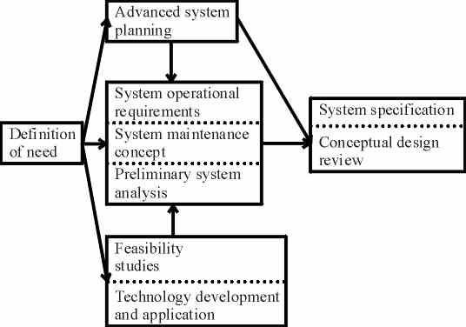
Proposed Architecture/System Design/ Data Flow Diagrams

Slide 12
Simulation Result
Simulation Result Simulation Result Simulation Result Simulation Result Simulation Result Simulation Result Simulation Result Simulation Result Simulation Result Simulation Result Simulation Result Simulation Result Simulation Result Simulation Result Simulation Result Simulation Result Simulation Result Simulation Result Simulation Result Simulation Result

Slide 13
System Design/ Prototype Module/ Software Application Results
System Design( Software and Hardware), System Implementation, System Testing, System Design( Software and Hardware), System Implementation, System Testing System Design( Software and Hardware), System Implementation, System Testing System Design( Software and Hardware), System Implementation, System Testing System Design( Software and Hardware), System Implementation, System Testing System Design( Software and Hardware), System Implementation, System Testing System Design( Software and Hardware), System Implementation, System Testing

Slide 14
Features of Proposed System
Features Proposed System Features Proposed System Features Proposed System Features Proposed System Features Proposed System Features Proposed System Features Proposed System Features Proposed System Features Proposed System Features Proposed System Features Proposed System Features Proposed System Features Proposed System Features Proposed System Features Proposed System Features Proposed System Features Proposed System

Slide 15
Conclusion and future work
Conclusion and future work Conclusion and future work Conclusion and future work Conclusion and future work Conclusion and future work Conclusion and future work Conclusion and future work Conclusion and future work Conclusion and future work Conclusion and future work Conclusion and future work Conclusion and future work Conclusion and future work Conclusion and future work Conclusion and future work

Slide 16
Referencing
Conclusion and future work Conclusion and future work Conclusion and future work Conclusion and future work Conclusion and future work Conclusion and future work Conclusion and future work Conclusion and future work Conclusion and future work Conclusion and future work Conclusion and future work Conclusion and future work Conclusion and future work Conclusion and future work Conclusion and future work

Slide 17
Referencing must be in IEEE
Proceedings Paper (Conference Paper) citation
[1] H. TOBUSHI, S. HAYASHI, K. HOSHIO, Y. MAKINO and N. MIWA, "SMS-09: Thermo mechanical Properties of Shape Memory Composites(SMS-II: SMART MATERIALS AND STRUCTURES, NDE)", The Proceedings of the JSME Materials and Processing Conference (M&P), vol. 2005, no. 0, p. 30, 2005.
Journal Paper Citation
[1] S. Ahmed and S. Rani, "A hybrid approach, Smart Street use case and future aspects for Internet of Things in smart cities", Future Generation Computer Systems, vol. 79, pp. 941- 951, 2018.

Slide 18



Suggestions and Questions

